Slide 1
Databases
Information system
Query system
Storage system
Data

Slide 2
Databases
Information system
Query system
Storage system
Data
Book
Book title
Sequence
Temperature
Picture
Video
Log files of web servers
etc

Slide 3
Databases
Bookshelves
Boxes
Text files/directories
Binary files
MySQL database
Oracle database
Information system
Query system
Storage system
Data

Slide 4
What is SQL?
SQL stands for Structured Query Language. It's used for creating, querying, updating and manipulating modern relational databases.
The SQL language can be divided into two major categories
Data Definition Language, or DDL, is used to define tables, indexes, and relationships.
Data Manipulation Language, or DML, is used to add, query, manipulate, and delete data from tables and datasets
SQL is specifically designed to work with relational databases.
SQL statements are not case sensitive.
Comments in SQL are line-oriented. A comment is introduced by a double-dash followed by at least one space and ends at the end of the line
select count(*) from country -- where continent = 'Asia'
multiline comments /* */

Slide 5
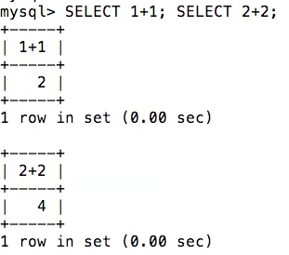
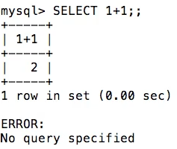
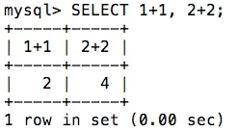
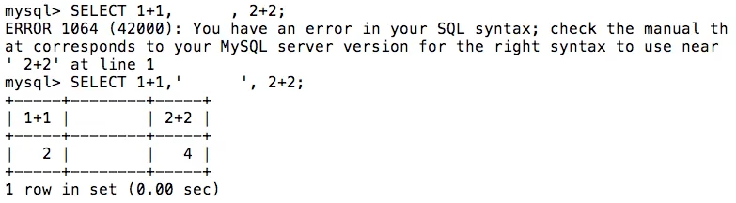

Slide 6
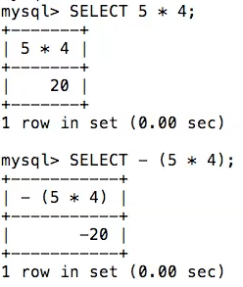
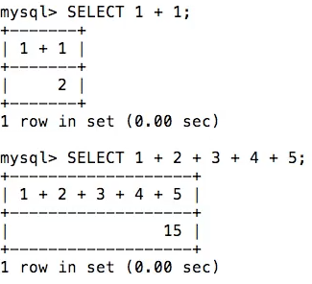
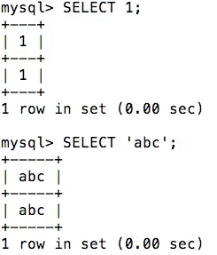
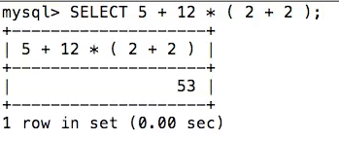

Slide 7
Select
select * from country
select * from country order by name
select name, Continent from country order by name
select * from country where Continent = 'Asia' order by name
select * from country where Continent = 'Asia' order by name limit 5
select name as country, Continent from country
select name country from country
select count(*) from country
select name as country, Continent from country

Slide 8
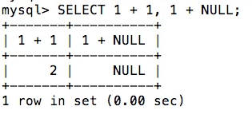
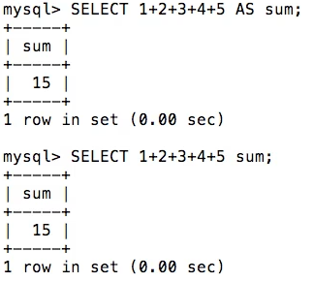
Null
Aliases

Slide 9
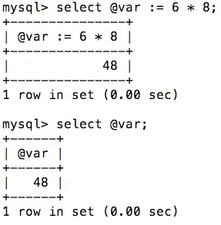
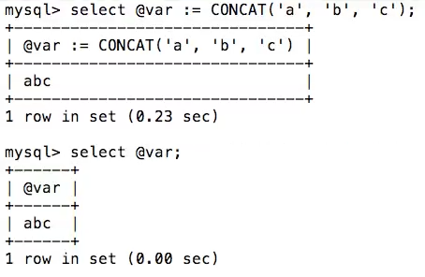
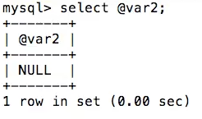
Variable Declaration

Slide 10
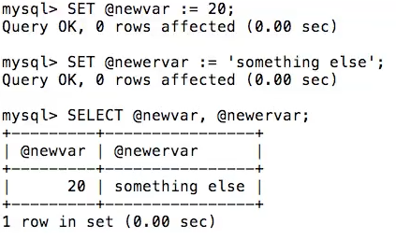
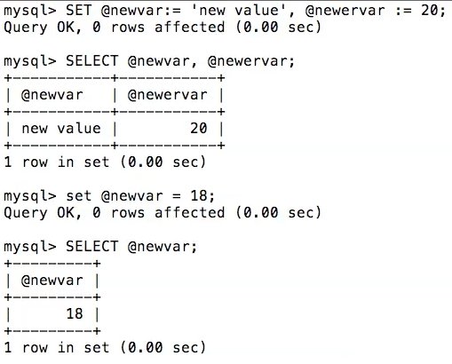
Set:- directly assign the value from 1 or more variable

Slide 11
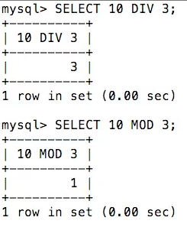
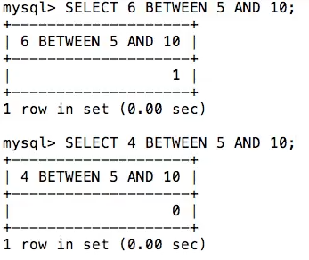
Operators
Between

Slide 12
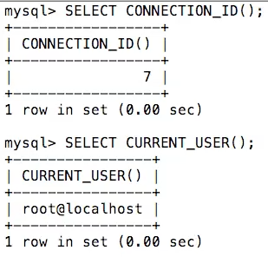
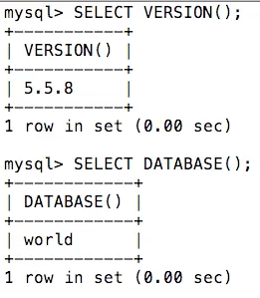
System Function

Slide 13
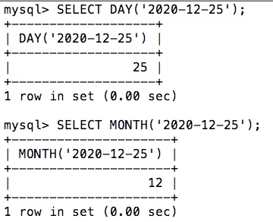
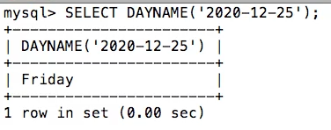
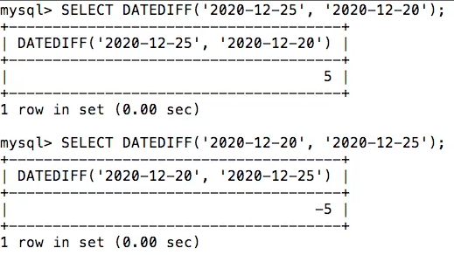

Slide 14
SHOW, CREATE & DROP DATABASE
SHOW DATABASES;
CREATE DATABASE demo1;
SHOW CREATE DATABASE demo1;
DROP DATABASE demo2;
DROP DATABASE IF EXISTS demo2;

Slide 15
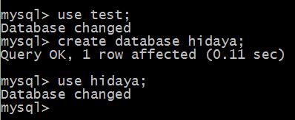
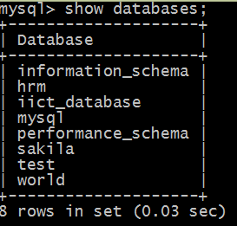
Show, create, use database

Slide 16
Mysql Data Types
Number
String
Binary

Slide 17
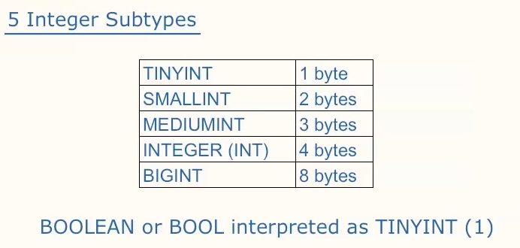
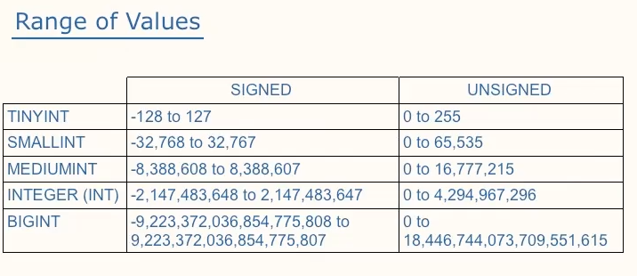
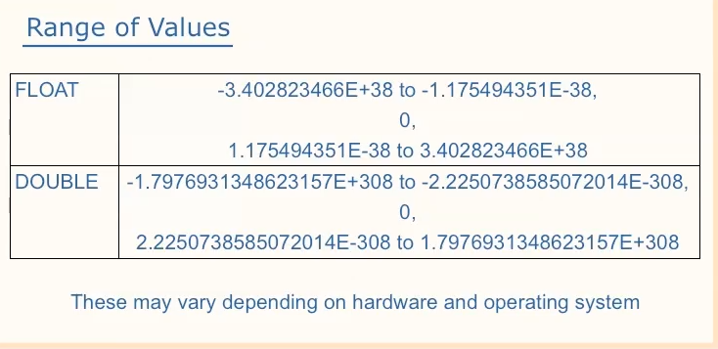

Slide 18
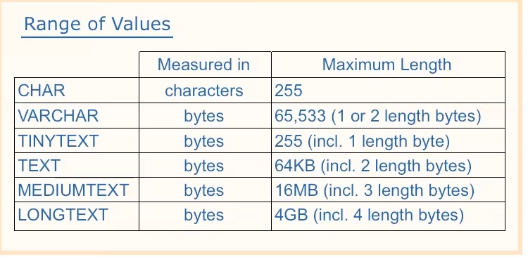
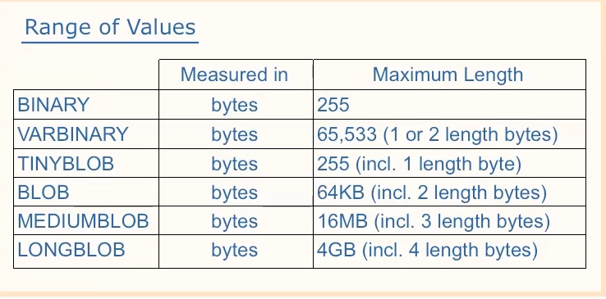

Slide 19
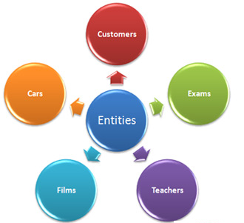
Entity
An entity are known as Table
A database contains one or more related tables. Each table holds all of the information about an object, person or thing
The entity name, a noun, is usually written in all capital letters
In both the Chen and Crow’s Foot notations, an entity is represented by a rectangle containing the entity’s name

Slide 20
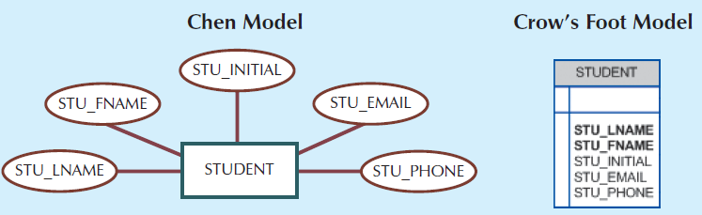
Attributes
Attributes are characteristics of entities. For example, the STUDENT entity includes these attributes STU_LNAME, STU_FNAME, and STU_ROLL.
Original Chen notation, attributes are represented by ovals and are connected to the entity rectangle with a line

Slide 21
Required / Optional Attributes, Domain
A required attribute is an attribute that must have a value; in other words, it cannot be left empty. As shown in last Figure there are two boldfaced attributes in the Crow’s Foot notation. STU_LNAME and STU_FNAME require data entries because of the assumption that all students have a last name and a first name
An optional attribute is an attribute that does not require a value; therefore, it can be left empty
a domain is the set of possible values for a given attribute (gender attribute have Male or Female values)

Slide 22
Composite and Simple Attributes
A composite attribute, not to be confused with a composite key, is an attribute that can be further subdivided to yield additional attributes. For example, the attribute ADDRESS can be subdivided into street, city, state, and zip code
A simple attribute is an attribute that cannot be subdivided. For example, age, marital status would be classified as simple attributes.

Slide 23
Single-Valued Attributes
A single-valued attribute is an attribute that can have only a single value. For example, a person can have only one Social Security number or one C-N-I-C, and a Vehicle-Register can have only one serial number.
Keep in mind that a single-valued attribute is not necessarily a simple attribute.
For example, a Vehicle-Register serial number, such as HAG-0001, is single-valued, but it is a composite attribute because it can be subdivided into the region and then vehicle number

Slide 24
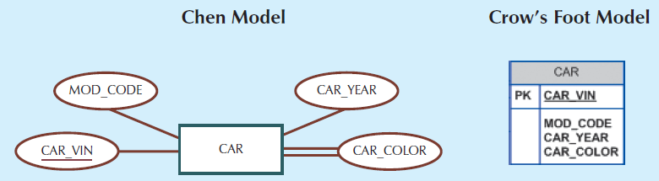
Multivalued Attribute
is an attributes that can have many values.
For instance, a person may have several college degrees, and a household may have several different phones, each with its own number. Similarly, a car’s color may be subdivided into many colors (that is, colors for the roof, body, and trim). In the Chen ERM, the multivalued attributes are shown by a double line connecting the attribute to the entity

Slide 25
Derived Attributes
A derived attribute is an attribute whose value is calculated (derived) from other attributes.
The derived attribute need not be physically stored within the database; instead, it can be derived by using an algorithm. For example, an employee’s age, EMP_AGE, may be found by computing the integer value of the difference between the current date and the EMP_DOB.

Slide 26
DDL(Data Defination Language) Create, Drop, Alter, Truncate, Rename
First Select The database where you create the table;
USE demo1;
CREATE TABLE people(id INT, NAME CHAR(10));
CREATE TABLE people3(id INT, NAME CHAR(10)) COMMENT = "FOR TESTING PURPOSE";
SHOW CREATE TABLE people2;
DESC people2;
SHOW CREATE TABLE people2;
SHOW CREATE TABLE people3;
RENAME TABLE people3 to employee;
Truncate employees;

Slide 27
CREATE TABLE CONTINUE
CREATE TABLE people4(id INT NOT NULL DEFAULT 0, NAME CHAR(10) NOT NULL DEFAULT '' COMMENT "FOR TESTING PURPOSE");
CREATE TABLE people5(id INT UNSIGNED NOT NULL DEFAULT 0, NAME CHAR(10) NOT NULL DEFAULT '' COMMENT "FOR TESTING PURPOSE");
CREATE TABLE people6(id INT NOT NULL UNSIGNED DEFAULT 0, NAME CHAR(10) NOT NULL DEFAULT '' COMMENT "FOR TESTING PURPOSE");
CREATE TABLE people7(id INT UNSIGNED PRIMARY KEY AUTO_INCREMENT , NAME CHAR(10) NOT NULL DEFAULT '' COMMENT "FOR TESTING PURPOSE");

Slide 28
DROP TABLE
DROP TABLE people;
DROP TABLE IF EXISTS people;

Slide 29
ALTER TABLE
Rename Table, ADD NEW COLUMN, DROP COLUMN,
ALTER TABLE people2 RENAME TO abc;
ALTER TABLE people2 ADD std_id INT , ADD std_name CHAR(10);
ALTER TABLE people5 DROP std_id ;
ALTER TABLE people5 MODIFY std_name INT;

